Slide 1

Case-cohort Study Design
Ziyuan Wang
Brown Research Group
November 18th
Notes:
Opening: Hi everyone! Thanks for coming today to the student seminar. My name is Ziyuan and I have been working on implementing the case-cohort design on HIV prep studies and under the mentoring from Clara, a former PhD student from the department. Today I will be giving a presentation about case-cohort study design and some preliminary results from simulation analysis. What I am doing right now will be part of a larger project.

Slide 2
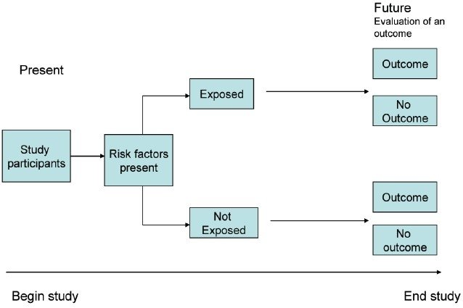
Prospective cohort study
In a prospective cohort study, researchers design and conduct the study before any participants develop any of the outcomes of interest. The group of people will be followed for a certain amount of time in order to record the development of outcome of interest (Gad, 2014).
https://www.ijstd.org/viewimage.asp?img=IndianJSexTransmDis_2012_33_1_49_93829_u3.jpg
Notes:
Firstly, I will give a brief introduction to the prospective cohort study and case-control study to provide some background knowledge

Slide 3
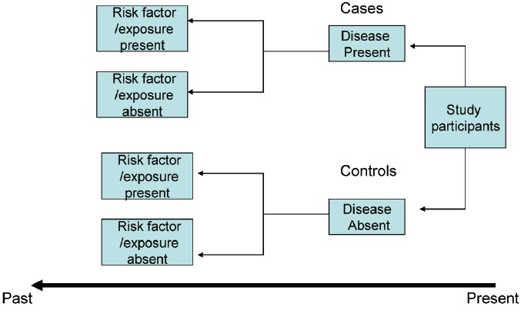
Case-control study
A case-control study often requires to look back in time. Researchers want to compare the frequency of past exposure between cases who developed the disease and controls who do not. Cases and controls will be identified first and then traced back to their exposure status (Gad, 2014).
https://www.ijstd.org/viewimage.asp?img=IndianJSexTransmDis_2012_33_1_49_93829_u5.jpg

Slide 4
Motivation and rationale
Assembling covariate information for all individuals in a cohort study can be difficult and expensive
We are unable to estimate rates or risks from a case-control study, and only one control group can be used for one outcome
An alternative approach?
Notes:
These two widely used study designs certainly have a lot of advantages. While in many epidemiological and disease prevention trials, the cost for getting covariate information from the full cohort is expensive (prentice).

Slide 5
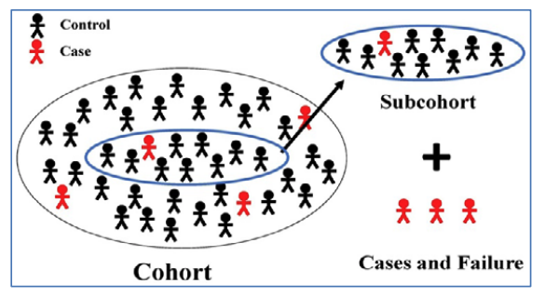
Introduction
Case-cohort study
A case cohort design involves the selection of a (stratified) random sample of the entire cohort, and the assembly of the covariate histories of the selected sub-cohort and for all cases outside of the sub-cohort (Prentice, 1986).
https://www.mcw.edu/-/media/MCW/Departments/Biostatistics/vol22no1kim.pdf?la=en
Notes:
The case-cohort design is a study scheme proposed by Prentice back in 1986. The purpose of such design is to select a specific group of patients from the full cohort and get inferences from the selected sub-cohort instead of the full cohort. As you can see on the slide, the picture represents such a selection. That larger eclipse represents the full cohort. And we will be collecting Covariate information from the selected sub-cohort and for all cases outside of the sub-cohort . As Prentice pointed out, if the sub-cohort is selected wisely, the statistical power of the association between predictor of interest and endpoints will not be reduced, comparing to the power of the association obtained from analyzing the full cohort.
Before I jump to some examples, I want to pause to see if there are any questions

Slide 6
Example I - Case-cohort analysis in the VOICE Trial
The VOICE trial was a randomized placebo-controlled trial evaluating efficacy of vaginal and oral interventions for prevention of HIV infection that included 5029 patients (Marrazzo et al., 2015).
Primary objective: To assess the efficacy of three pre-exposure prophylaxis interventions : oral tenofovir disoproxil fumarate (TDF), oral tenofovir-emtricitabine (TDF-FTC), and 1% tenofovir (TFV vaginal gel)
Secondary objective: To assess the adherence to study products.
- Plasma tenofovir level as a measure of adherence
- For the analysis of plasma tenofovir level, a random sub-cohort of 647 was selected from the active arm and enriched by remaining cases.
Notes:
Now I want to switch gear to talk about its implementations. The first example I want to talk about is the Vaginal and Oral Interventions to Control the Epidemic (VOICE) study, where the design was used to analyze plasma drug concentration (voice). A little bit background, he VOICE trial was a randomized placebo-controlled trial evaluating the efficacy of three vaginal and oral interventions, including oral tenofovir disoproxil fumarate (TDF), oral tenofovir-emtricitabine (TDF-FTC), and 1% tenofovir (TFV vaginal gel). The study includes 5029 patients in total.
Their secondary objective was to assess the adherence to to study treatment TFV gel, via the measurement of plasma TFV concentration quantitatively. However, plasma drug level is both expensive and time consuming to measure for a large cohort of participants. So researches chose to implement this design, and a sub-cohort of 647 was a randomly selected subsample from the treatment arm with all the remaining patients who got HIV infection (voice).

Slide 7
Example II - The case-cohort analysis in the MORGAM project
The MORGAM (MONICA, Risk, Genetics, Archiving, and Monograph) Project follows a cohort prospectively for all cause mortality and non-fatal coronary heart disease (CHD) and stroke events ((Kulathinal et al., 2007).
Aim to discover the relationships between cardiovascular disease outcomes and their risk factors, both classical and genetical.
Since genotyping is expensive and time consuming, they choose to do case-cohort design.
Notes:
Our goal is to implement this study design to a secondary analysis of the ASPIRE trial result, and we are interested in the method to sample the subcohort. After doing literature reviews, we found the paper by Kulathinal et al. that gives an extensive review of case-cohort weighting method and variance estimation, and also detailed procedure for doing sampling and analysis. Their paper illustrate experience from the MORGAM project, which is a multinational collaborative study that focuses on a certain number of phenotypes and genetic factors. Their goal is to explore the possible relationships between the cardiovascular disease outcomes and their classic and genetic risk factors.
Pause

Slide 8
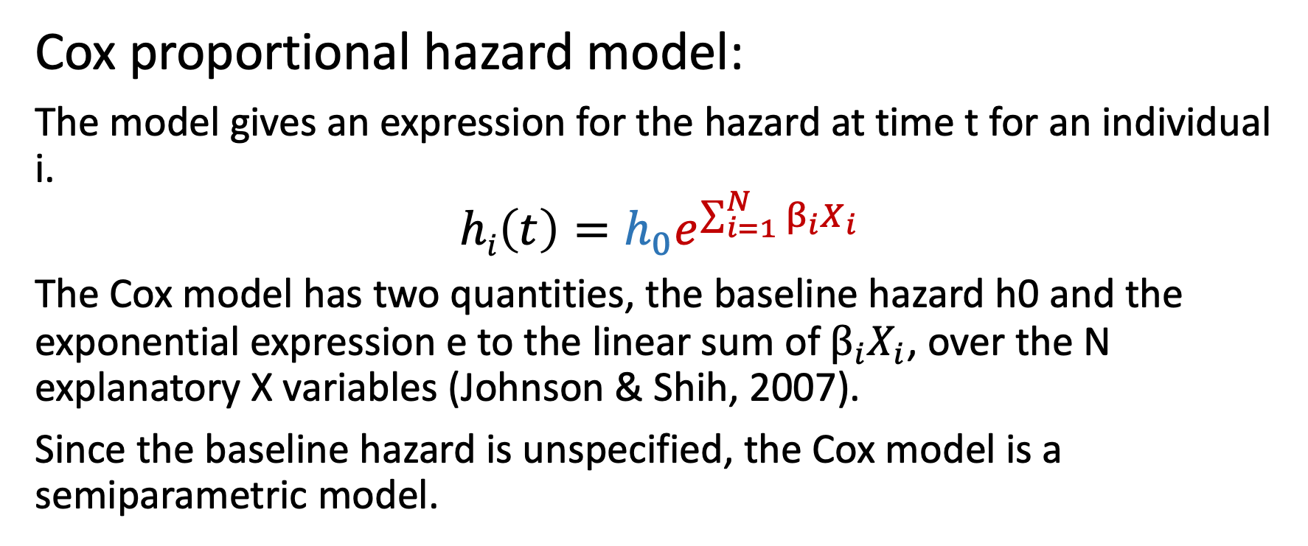
Analysis of time-to-event data
Cox proportional hazard model:
The model gives an expression for the hazard at time t for an individual i.
$$hi\left(t\right)=h_{0}e^{\sum_{i=1}^{N}{β_{i}}X_{i}}$$
The Cox model has two quantities, the baseline hazard h0 and the exponential expression e to the linear sum of ${β_{i}X}_{i}$, over the N explanatory X variables (Johnson & Shih, 2007).
Since the baseline hazard is unspecified, the Cox model is a semiparametric model.
Notes:
Before getting to the survival analysis under a case-cohort design, I want to first talk briefly about the standard cox proportional hazard model for analyzing survival data. The model gives an expression for the hazard at time t for an individual I, and has two quantities, the baseline hazard h0 and the exponential expression e to the linear sum of beta i x i, over the N explanatory X variables. As you may heard, the cox ph is popular since the baseline hazard is unspecified, and thereby the Cox model is a semiparametric model.

Slide 9
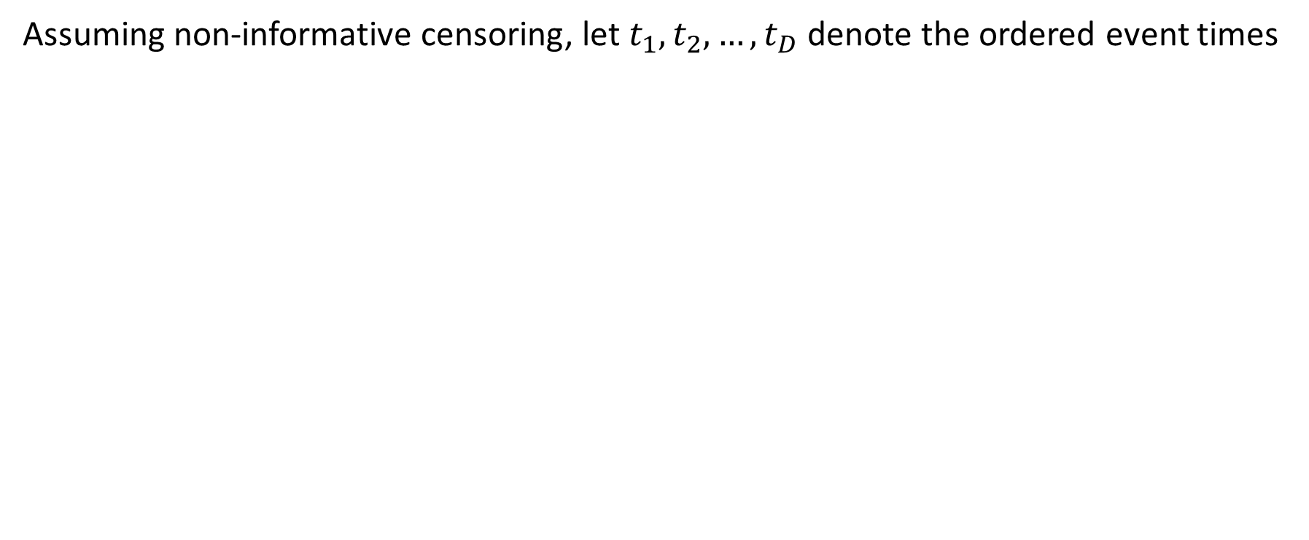
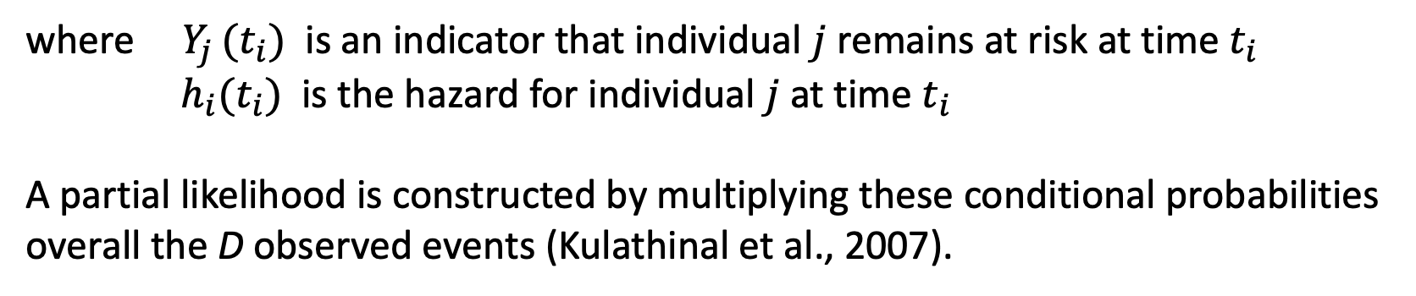
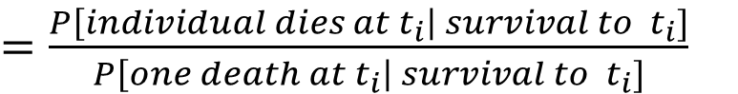
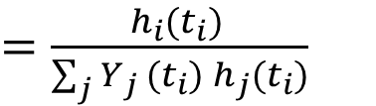
Analysis of time-to-event data
Assuming non-informative censoring, let $t_{1},t_{2},…,t_{D}$ denote the ordered event times
$$P\left[individual dies at t_{i}\right|one death at t_{i}]$$
$=\frac{P\left[individual dies at t_{i}\right| survival to{ t}_{i}]}{P\left[one death at t_{i}\right| survival to{ t}_{i}]}$
$=\frac{h_{i}(t_{i}) }{{\sum_{j}{Y_{j }(t_{i}) }h}_{j}(t_{i})}$
where $Y_{j }(t_{i})$ is an indicator that individual $j$ remains at risk at time $t_{i}$
$h_{i}(t_{i})$ is the hazard for individual $j$ at time $t_{i}$
A partial likelihood is constructed by multiplying these conditional probabilities
overall the D observed events (Kulathinal et al., 2007).
Notes:
So this slide is showing the analysis of time to event data under a case-cohort design scenario.
The probability of event happening to individual I given an event and the risk set at time Ti.

Slide 10
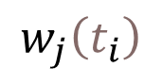
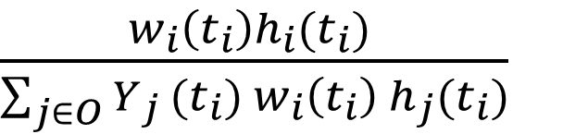
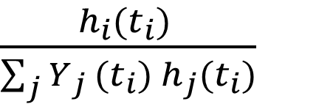
Analysis of time-to-event data
In a case-cohort design, the subset of individuals is not a random sample (cases are over-represented).
Standard expression for partial likelihood contribution for cases in the full cohort:
Expression for partial likelihood contribution in case-cohort analysis:
$\frac{{w_{i}\left(t_{i}\right)h}_{i}(t_{i}) }{{\sum_{j∈O}{Y_{j }(t_{i}) }w_{i}\left(t_{i}\right) h}_{j}(t_{i})}$
$\frac{h_{i}(t_{i}) }{{\sum_{j}{Y_{j }(t_{i}) }h}_{j}(t_{i})}$
$$w_{j}\left(t_{i}\right)$$
is a time-dependent weight for individual j
Notes:
In case cohort studies, Cox model is carried out with adjusting or weighting the standard partial likelihood and various weighting methods has been proposed. The standard expression for a partial likelihood, with the contribution for the individual i failing at $T_{i}$ (i $∈$ cases) in the full cohort (C) is this first equation. where $Y_{j}\left(T_{i}\right)$ is the at-risk indicator and $λ_{j}\left(T_{i}\right)$ is the hazard rate for individual j at event time $T_{i}$ (MORGAM). The interpretation of this is the probability of event happening to individual i given that a failure occurred, and the risk set at time $T_{i}$.
Pause

Slide 11
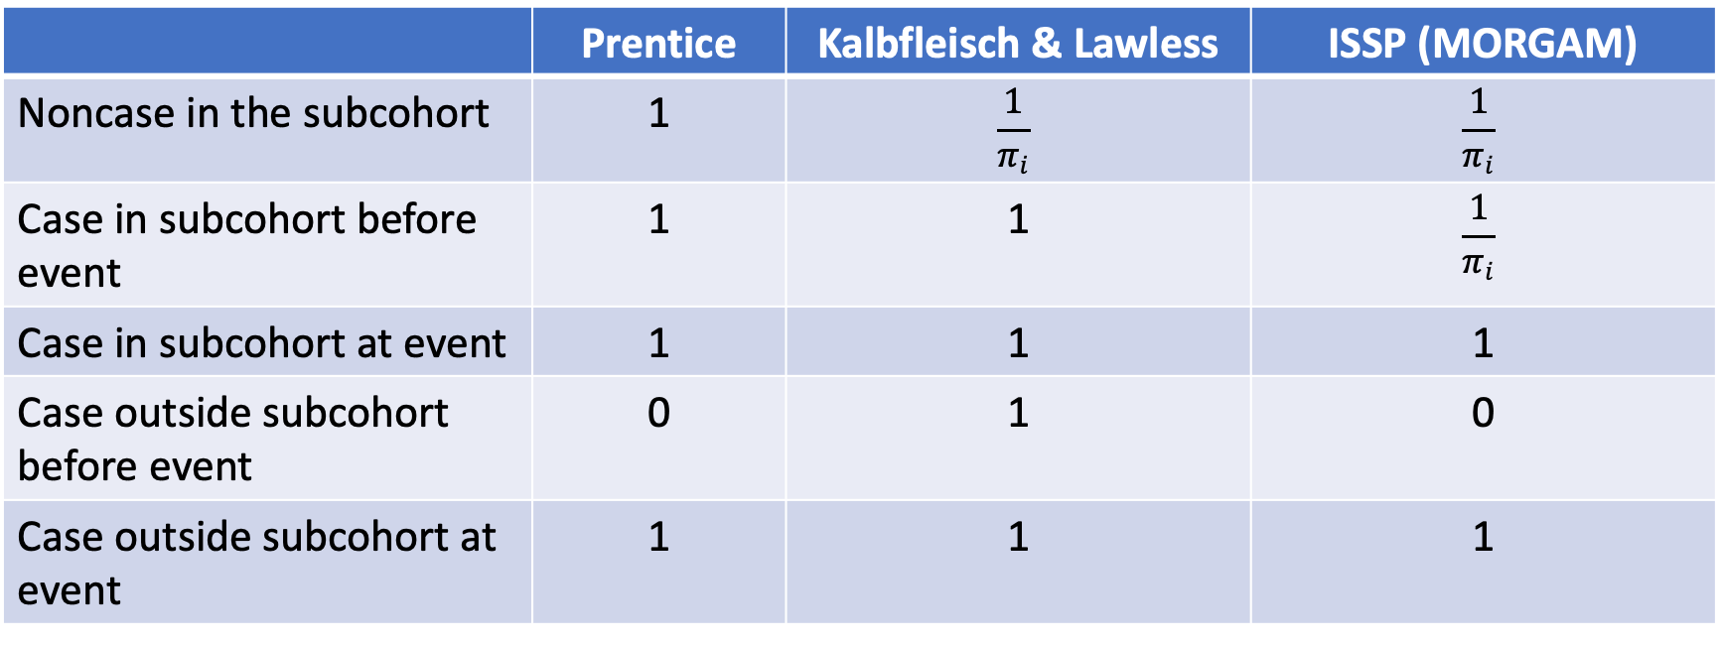
Weighting method
 | Prentice | Kalbfleisch & Lawless | ISSP (MORGAM)
Noncase in the subcohort | 1 | $$\frac{1}{π_{i}}$$ | $$\frac{1}{π_{i}}$$
Case in subcohort before event | 1 | 1 | $$\frac{1}{π_{i}}$$
Case in subcohort at event | 1 | 1 | 1
Case outside subcohort before event | 0 | 1 | 0
Case outside subcohort at event | 1 | 1 | 1
Table 1. The Prentice method proposed no weighting. Cases outside of the subcohort are included in the risk set only for a short period of time. The ISSP method is proposed in the MORGAM paper.
Notes:
In the MORGAM project, the subcohort sampling probabilities are defined at individual level. So they weight the subcohort members with the inverse of their individual sampling probabilities, with cases outside the subcohort contributing to the risk set only at their event time. Kalbfleisch and Lawless proposed a slightly different method, that the cases outside the subcohort contribute to the risk set with weight one and the remaining subcohort members are weighted with the inverse of subcohort sampling probabilities.

Slide 12
Baseline variable-adjusted sampling - Rationale
In some cases, the number of major endpoint events during the follow-up increases strongly with the age of the individual at baseline.
For example:
-Risk of cardiovascular disease increases with age
-Risk of HIV infection likely associated with age
Adjusting the selected probability based on age can increase power by selecting the individuals of the subsample in such a way that the age distribution is similar in the sub-cohort and in the cases.
Notes:
In the MORGAM paper, they found that major endpoint events are related to the baseline age of the participant. Scientifically, risk of cardiovascular disease increases as age increases. So, a simple random sampling method will lead to lack of power since the mean age for cases will be larger than the mean age of the subcohort. To deal with this problem, they used a baseline variable-adjusted sampling method using age distribution similar to the distribution of the baseline age of the cases, a method that is originally proposed by Kim and De Gruttola. We are interested in this method since in HIV prevention settings, potentially, there are also variables related to HIV infection, such as age and certain bacteria infections.

Slide 13
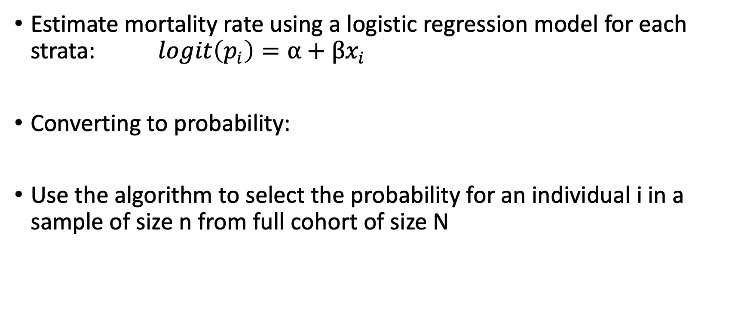
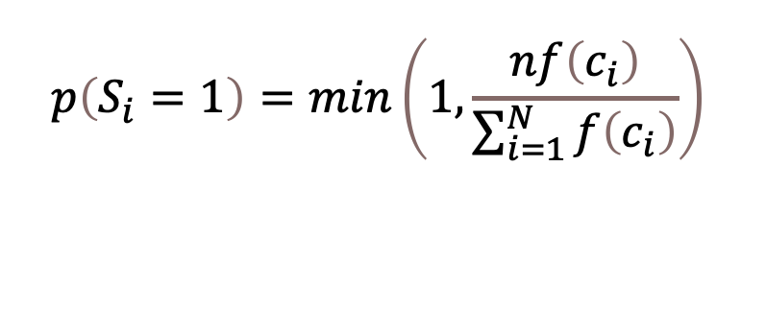
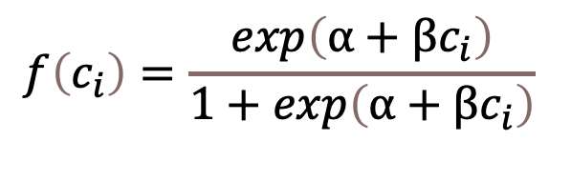
Age-adjusted sampling - Procedure
Estimate mortality rate using a logistic regression model for each strata: $logit\left(p_{i}\right)=α+βx_{i}$
Converting to probability:
Use the algorithm to select the probability for an individual i in a sample of size n from full cohort of size N
$$f\left(c_{i}\right)=\frac{exp\left(α+βc_{i}\right)}{1+exp\left(α+βc_{i}\right)}$$
$$p\left(S_{i}=1\right)=min\left(1,\frac{nf\left(c_{i}\right)}{\sum_{i=1}^{N}{f\left(c_{i}\right)}}\right)$$
Notes:
This slide is showing their procedure for the variable adjusted sampling. The first step is to perform logistic regression for each individual in the cohort. After obtaining the two regression coefficients, we can plug in into the function that converts the odds ratios into probabilities. There is one additional standardization step in the ultimate selection algorithm in the paper by Kulathinal et al, that also accounts for the fact that probability cannot exceed 1. Where $S_{i}$ is a binary random variable taking value 1 if participant is selected to the subcohort and 0 otherwise (MORGAM). N is the total cohort size and n is the sample/subcohort size. We are focusing on the first and the second step for our simulation study. And in our simulation make those probability that exceed 1 to be equals 1.

Slide 14
Simulation result from the MORGAM paper
Fixed effect | Sampling design | Weighting method | Mean | sd | Mean est. sd | Power
0.0 | Cohort | - | -0.021 | 0.256 | 0.247 | 0.052
 | CC(SRS) | Prentice | -0.001 | 0.404 | 0.362 | 0.076
 | CC(MORGAM) | Prentice | -0.010 | 0.321 | 0.310 | 0.053
0.3 | Cohort | - | 0.296 | 0.238 | 0.231 | 0.283
 | CC(SRS) | Prentice | 0.325 | 0.391 | 0.347 | 0.188
 | CC(MORGAM) | Prentice | 0.313 | 0.312 | 0.297 | 0.207
Table 2. The cohort had a size of 2074, and the subcohort was set to 208. The fixed effect 𝛄 here is the relative hazard parameter for the simulated covariate. The SRS method refers to subcohort selection with simple random sampling, and the MORGAM method refers to the subcohort selection with age adjustment. The age adjusted subcohort selection gives lower variance and mean estimate standard deviation.

Slide 15
Simulation – Background and objective
We are trying to replicate the simulation dataset in "Strategies for cohort sampling under the cox proportional hazards model, application to an AIDS clinical trial", by Kim and De Gruttola (Soyeon Kim & De Gruttola, 1999).
The dataset try to resemble ACTG 019, a phase III clinical trial in AIDS study.
Aim:
To replicate their result using the baseline variable adjusted sampling method
Make changes to the dataset for our HIV PrEP study purpose
Notes:
For our simulation, we are trying to replicate the simulation dataset in "Strategies for cohort sampling under the cox proportional hazards model, application to an AIDS clinical trial", by Kim and De Gruttola

Slide 16
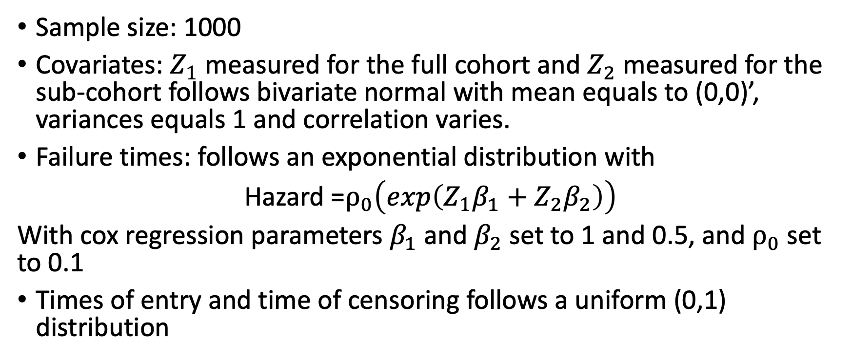
Simulation – Dataset description
Sample size: 1000
Covariates: $Z_{1}$ measured for the full cohort and $Z_{2}$ measured for the sub-cohort follows bivariate normal with mean equals to (0,0)’, variances equals 1 and correlation varies.
Failure times: follows an exponential distribution with
Hazard =$ρ_{0}\left(exp\left(Z_{1}β_{1}+Z_{2}β_{2}\right)\right)$
With cox regression parameters $β_{1}$ and $β_{2}$ set to 1 and 0.5, and $ρ_{0}$ set to 0.1
Times of entry and time of censoring follows a uniform (0,1) distribution
Notes:
Here, we have two covariates, Z1 and Z2, that follows a bivariate normal distribution with mean equals to (0,0)' and both variances equal to 1, and correlation varies. Failure times were generated according to an exponential distribution with hazard rho0(exp(Z1beta1+Z2beta2)). The cox regression parameters beta 1 and beta 2 were set to 1 and 0.5 respectively, and rho0 to 0.1. Time of entry into the study were generated by a uniform (0,1) distribution, hence time of censoring is also uniform (0,1) (AIDS). CCh function
The first covariate Z1 is observed for the entire cohort, and Z2, in theory, is observed only for the failures and the selected controls. In real-life settings, Z1 can be a covariate that is surrogate variable and Z2 is our predictor of interest. The surrogate variable may or may not be correlated to our predictor of interest, but we want to know its potential influence on the endpoint, which is HIV infection.

Slide 17
Simulation – Result part I
Fig 1. Comparing variances and relative efficiency for SRS and Z₁-adjusted sampling methods with varied sub-cohort size with correlation = 0.5.
Notes:
After obtaining the simulation dataset, we tested out the baseline variable adjusted sampling method and compared it with the simple random sampling method. For subcohort sizes of 100 to 500, with 25 people as the increment, we calculated variances and relative efficiency for coefficient beta 1 and beta 2 for both methods、On the left panel, you can see the relative efficiency vs. subcohort size plot, and on the right panel, the variance vs subcohort size plot. In both graphs, the red colored lines represent results for beta 1, and the blue lines represent results for beta 2. And the solid line shows the result from Z1-adjusted sampling and the dashed line shows the result from SRS sampling.

Slide 18
Simulation – Result part II
Fig 2. Comparing variances and relative efficiency for SRS and Z1-adjusted sampling methods with varied sub-cohort size with correlation = 0.1.

Slide 19
Simulation – Result part III
Fig 3. Comparing variances and relative efficiency for SRS and Z1-adjusted sampling methods with varied sub-cohort size with correlation = 0.8.

Slide 20
Simulation – Result IV
Fig 4. Comparing variances for SRS and Z1-adjusted sampling method with varied correlation between Z1 and Z2 for coefficient for Z2.

Slide 21
Other works
Comparing the CCH function to the code from the MORGAM paper
Exploring different weighting methods of the CCH function (eg. Barlow weighting scheme for stratified sampling)
Compiling paper that uses case-cohort design for literature review

Slide 22
Work in progress
We want to address heterogeneous HIV exposure in case-cohort studies
- The HIV exposure rate varied across the study population, and a large proportion of the participant are never exposed
- Result in diluted estimates of the association for predictors of interest
Our interest is to evaluate the association between Bacterial Vaginosis (BV) and HIV exposure
- BV is correlated with HIV exposure
- BV as a potential confounder and effect modifier

Slide 23
New simulation set-ups
Sample size: 10 sites and 250 participants per sites
HIV exposure rates are different across sites
BV is positively correlated with BV
HIV infection hazard is related to treatment assignment only
We are exploring different sampling methods such as the simple random sampling (SRS), and probability base sampling [P(HIV Infection | site] with logistic regression estimated probabilities and HIV infection probabilities per site.

Slide 24
References
Case-control study. (n.d.-b). Retrieved November 18, 2020, from https://www.ijstd.org/viewimage.asp?img=IndianJSexTransmDis_2012_33_1_49_93829_u3.jpg
Gad, S. C. (2014). Epidemiology. In Encyclopedia of Toxicology: Third Edition (pp. 433–437). Elsevier. https://doi.org/10.1016/B978-0-12-386454-3.00841-1
Johnson, L. L., & Shih, J. H. (2007). An introduction to survival analysis. In Principles and Practice of Clinical Research (pp. 273–282). Elsevier Inc. https://doi.org/10.1016/B978-012369440-9/50024-4
Kim, Soyeon, & De Gruttola, V. (1999). Strategies for Cohort Sampling under the Cox Proportional Hazards Model, Application to an AIDS Clinical Trial. Lifetime Data Analysis, 5(2), 149–172. https://doi.org/10.1023/A:1009601512314
Kim, Soyoung. (n.d.). Case-Cohort Studies vs Nested Case-Control Studies (Vol. 22, Issue 1).
Kulathinal, S., Karvanen, J., Saarela, O., & Kuulasmaa, K. (2007). Case-cohort design in practice - Experiences from the MORGAM Project. In Epidemiologic Perspectives and Innovations (Vol. 4).
Marrazzo, J. M., Ramjee, G., Richardson, B. A., Gomez, K., Mgodi, N., Nair, G., Palanee, T., Nakabiito, C., van der Straten, A., Noguchi, L., Hendrix, C. W., Dai, J. Y., Ganesh, S., Mkhize, B., Taljaard, M., Parikh, U. M., Piper, J., Mâsse, B., Grossman, C., … Chirenje, Z. M. (2015).
Prentice, R. L. (1986). A Case-Cohort Design for Epidemiologic Cohort Studies and Disease Prevention Trials. Biometrika, 73(1), 1. https://doi.org/10.2307/2336266
Prospective cohort study. (n.d.-a). Retrieved November 18, 2020, from https://www.ijstd.org/viewimage.asp?img=IndianJSexTransmDis_2012_33_1_49_93829_u5.jpg

Slide 25

Any questions?
zwang24@uw.edu

